Slide 1
Secure your email

Slide 2
ISO model for messageing (X.400)
UA
MTA
MTA
X.509
MS
DAP
Directory
LDAP
DNS
Notes:
ISO känner alla till,
X.400 were the core of Microsoft Exchange until 2006
X.400 adressing complicated, using redundant feilds (C, O, OU, G, S, PRMD, ) to handle partial/wrong adress info (cmp postal service)
X.500 -> LDAP
X.509 -> X.509

Slide 3
Concepts
SMTP
MX
START TLS
IMAP
TXT
SPF
DKIM
ACTIVE SYNC
DMARC
MTA-STS
Time
Notes:
MTA store-and-forward (never lose an email)
Why is everything email in upper case?

Slide 4

Per Josefsson
OWASP JKPG
G=Per ;I=J ;S=Josefsson ;O=OWASP ;OU1=JKPG ;P=ddm ;C=Sweden; PD-OF=OWASP; PD-S=Stora vägen 1; PB-PC=123 45
Notes:
X.400
Notification of delivery
Cannot spoof email adress wounder why
Computing efficiency (performance) ASN1

Slide 5
SMTP
STARTTLS
S: 220 smtp.example.com ESMTP Postfix
C: EHLO relay.example.com
S: 250-smtp.example.com, I am glad to meet you
S: 250 SIZE 65536
C: MAIL FROM:<charlie@evil.com>
S: 250 Ok
C: RCPT TO:<alice@example.com>
S: 250 Ok
C: RCPT TO:<theboss@example.com>
S: 250 Ok
C: DATA
S: 354 End data with <CR><LF>.<CR><LF>
C: From: "Bob Example" <bob@example.com>
C: To: Alice Example <alice@example.com>
C: Date: Tue, 15 Jan 2008 16:02:43 -0500
C: Subject: Test message
C:
C: Hello Alice.
C: This is a test message with
C: .
S: 250 Ok: queued as 12345
C: QUIT
S: 221 Bye {The server closes the connection}
Notes:
RFC821 -> RFC2821
25 / 587
MAIL FROM
FROM
Dot-stuffing
Ingen authenticering
Stoppa open relays
Sedan authenticering för att sända utanför domänen
What could possibly go wrong

Slide 6
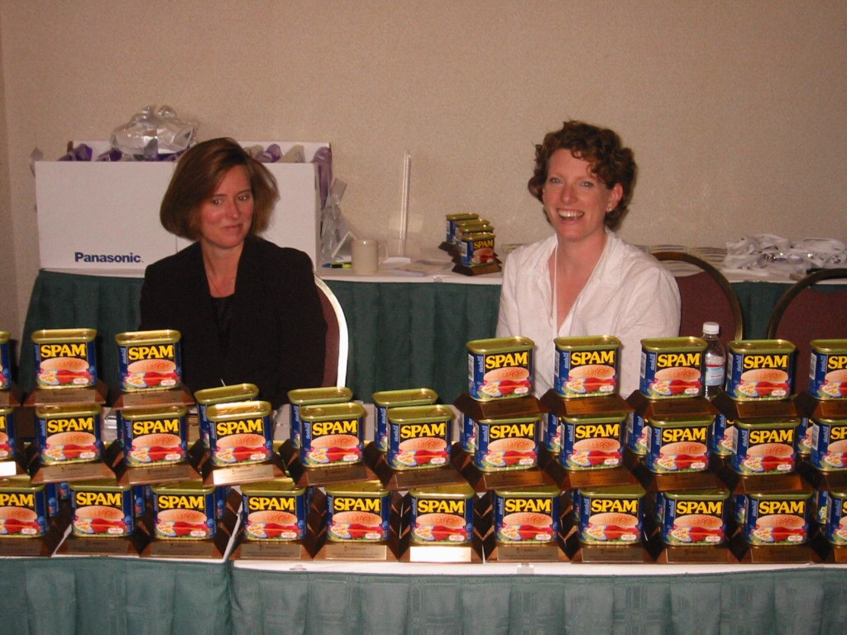
X
Notes:
Santa barbara år 2003
Löst sammanhållna initiativ
Flera olika lösningar föreslogs

Slide 7
SPF
SMTP receive an email
Mail From: user@ddm.se
Lookup SPF-record in DNS
MX
? +/~/?x
Lookup MX-record
192.168.1.1
Receive message
Reject message
v=spf1 ip4:192.0.2.0/24 mx include:smarter.se -all
Notes:
RFC 7208 per 2014
SPF tillämpas / enforseas av mottagaren, oftast inte ditt mailsystem!
Anger vilka hostar (IP-adresser / FQN hostname ) som får sända epost med Mail From:
To rid domain owners of all delivery failure mesages
Input for the spam-filter
Spammers will be idenfiable
Breaks plain mesage forwarding (newer drop a message)
Mailinglist forwarding an email but keep the return-path
Next hop/MTA not whitelisted
SPF policy syntax error => Permanent error / ABORT
SPF policy operators and parameters [net slide]

Slide 8
SPF RR syntax
Operators
+ (implicit)
-
~
?
Directives
all
mx
include
a
ipv4
ipv6
ptr
exists
redirect
exp

Slide 9
SPF parent & child
Example 2: SPF in alignment (parent):
MAIL FROM: <sender@child.example.com>
From: sender@example.com
Date: Fri, Feb 15 2002 16:54:30 -0800
To: receiver@example.org
Subject: here's a sample
Notes:
Parentes
Simple for example.com
What about example.co.uk
SPF strict or relaxed
http://publicsuffix.org
Avoid privacy-damaging "supercookies" being set for high-level domain name suffixes
Highlight the most important part of a domain name in the user interface
Accurately sort history entries by site

Slide 10
DKIM
Received: from [172.16.117.57] (unknown [194.236.49.11])
(using TLSv1.2 with cipher ECDHE-RSA-AES256-GCM-SHA384 (256/256 bits))
(No client certificate requested)
by ddm.se (Postfix) with ESMTPSA id 2DCFCA6DC08
for <per.josefsson@pulsen.se>; Thu, 16 May 2019 07:40:15 +0200 (CEST)
DKIM-Signature: v=1; a=rsa-sha256; c=relaxed; d=ddm.se; s=001;
t=1557985215; bh=BYHjJEEQX5fFwHMnm87o1Js17Fta6Hp+u/7oh9GDCQE=;
h=From:Date:Subject:To;
b=kSzGR6db2AIm5rCkNIXfoyngKTjaAOMFhLEEUMGXyIxr1m6SDvLtLTN1AUGZPEzb9
LpekqkGSPqJm/8JRQ4MTbcdYcnWZT+DPRNvMI88UcO93XnVRqDCn18K5CtENhgnrjU
NtKj7+mDiDSzUwyyrYjtB1jbCSOOZQ7usNYrHqtI=
Content-Type: multipart/mixed;
boundary="Apple-Mail-676818E7-493B-4089-86AA-CDB76E7C7649”
From: Per Josefsson <per@ddm.se>
Date: Thu, 16 May 2019 07:40:13 +0200
Notes:
Objective of DKIM
Nobody should be able to send email as if they originated from a system you control.
You can stop inbound messages looking like sent within your organisatoin.
selector._domainkey.example.net

Slide 11
DKIM
SMTP receive an email
Hash named headers;
Lookup DKIM-record (001._domainkey.ddm.se) in DNS
P=MIGfMA0GCSqGSIb3D…
? H ok
Decrypt hash with P
Consider receiveing message
Consider rejecting message
v=DKIM1\; k=rsa\; p=MIGfMA0GCSqGSIb3DQEBAQUAA4GNADCBiQKBgQC5o7FC4ZpP7mis5X+9 WPfIRmUYhT+BKckUB2Q/yZ/eBOmqcTCj7tpNMHxowdbWGzLTfps08UgXbAiB+m871XQ7+VrHU13HGKqGZU2Q0ZGu6B3KyMa0e8eSUxwVI+5V0sxQdGUctNJJP5x9CkkVT7LF6SZ3MXDa1fl/gC5TEzDfDwIDAQAB
Notes:
Again loose or strict, parrent and child domains
Non-repudiability
Replaying signatures
Content modificatoin / mailinglists

Slide 12
v, version
a, signing algorithm
d, domain
s, selector
c, canonicalization algorithm(s) for header and body
q, default query method
t, signature timestamp
x, expire time
h, header fields - list of those that have been signed
bh, body hash
b, signature of headers and body

Slide 13
DKIM pub key lookup
$ nslookup
> set Q=TXT
> 001._domainkey.ddm.se
Non-authoritative answer:
v=DKIM1\; k=rsa\; p=MIGfMA0GCSqGSIb3DQEBAQUAA4GNADCBiQKBgQC5o7FC4ZpP7mis5X+9 WPfIRmUYhT+BKckUB2Q/yZ/eBOmqcTCj7tpNMHxowdbWGzLTfps08UgXbAiB+m871XQ7+VrHU13HGKqGZU2Q0ZGu6B3KyMa0e8eSUxwVI+5V0sxQdGUctNJJP5x9CkkVT7LF6SZ3MXDa1fl/gC5TEzDfDwIDAQAB
Notes:
selector._domainkey.example.net

Slide 14
DMARC
Domain-based Message Authentication, Reporting, and Conformance
SMTP receive an email
Extract ”From:”;
Lookup policy;
run SPF & DKIM;
?
Consider receiving message
Consider quarantine message
Consider rejecting message
Report
Notes:
Oups, we have SPF and DKIM but still uncolicited and fraudulent email!! Let’s invent DMARC.
Conformance = Mail From: == From:
Reporting
Authentication = Link to SPF and DMARC

Slide 15
DMARC
$ nslookup
> set q=TXT
> _dmarc.ddm.se.
answer:
_dmarc.ddm.se text = "v=DMARC1\; p=reject\; rua=mailto:j6upbyys@ag.dmarcian-eu.com\;"
Notes:
RFC 7489 2015
Protects from BEC, phising
Provides reporting
Extends SPF || DKIM, ie., not much in itself
DMARC controlled email are less likely to be stoped in SPAM filters
Verifies Allignment: Mail From: == From:
Agregate reports (when sent to another domain, requiers a special DNS entry ”domain.se._report_dmarc.domain.se”)

Slide 16
DMARC RR syntax
Tag | Value
v | Version ”DMARC1”
p | Policy ”none|quarantine|reject”
adkim | Strict or relaxed domain component for DKIM
aspf | Strict or relaxed domain component for DKIM
fo | When to report a failure ”0 (defult) | 1|d|s”
pct | % of email to enforce the policy on (default 100)
rf | Report format ”afrf (default)
ri | Report interval in seconds (default 86400)
rua | Where to send aggregate reports
ruf | Where to send forensic reports
sp | Subdomain policy ”none|quarantine|reject”
Cheat sheet

Slide 17
What you should do
Deploy DKIM & SPF. You have to cover the basics, first.
Ensure that your mailers are correctly aligning the appropriate identifiers.
Publish a DMARC record with the “none” flag set for the policies, which requests data reports.
Analyze the data and modify your mail streams as appropriate.
Modify your DMARC policy flags from “none” to “quarantine” to “reject” as you gain experience.

Slide 18
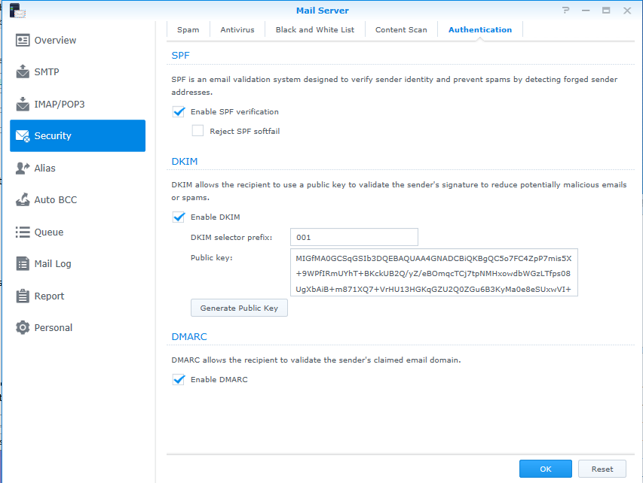

Slide 19
STARTTLS
STARTTLS
S: 220 smtp.example.com ESMTP Postfix
C: EHLO relay.example.com
S: 250-smtp.example.com, I am glad to meet you
S: 250 SIZE 65536
C: MAIL FROM:<charlie@evil.com>
S: 250 Ok
Notes:
Oportunistic
MITM
DNS spoofing
E.g., Outlook 2016 klarar inte ”modern” TLS settings

Slide 20
MTA-STS
STARTTLS Everywhere
https://mta-sts.ddm.se/.well-known/mta-sts.txt
_mta-sts.ddm.se. 300 IN TXT
"v=STSv1; id=aca9f86d663;"
Notes:
Strict Transport Security har funnits länge för https, nu även en variant för SMTP!
If not, tamper with sessions or DNS (adding an extra hop)
DNSSEC + DANE solves the same problem, but is seldome implemented
STARTTLS Everywhere – EFF
1) opt-in
2) Reliable MX data

Slide 21
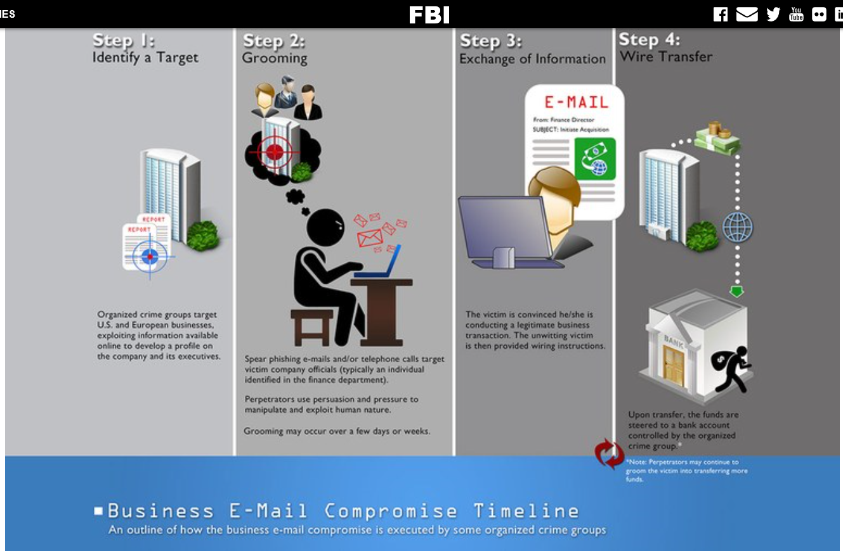
Notes:
Phishing starting with a general employee and elevating to the CFO
If your organisation are compromized, that may be used to attack a customer of yours.

Slide 22


Extra

